Slide 1
Beat the Market
(Stock Portfolio Analysis)
max growth
Team Members :
Abhinav Anand
Siddham Bagrecha
Anurag Ranjan
Ayush

Slide 2
The Abstract
A data driven approach for making a portfolio comprising of top 8 performing virtual stocks out of given 20 stocks providing the rationale and logic behind the selection by citing the relevant data such as financial statements, articles etc.
Each team will have a virtual fund of ₹20 lakh to build their portfolio.
Providing a detailed explanation of why the remaining 12 stocks were not included in your portfolio.
Optimization of portfolio by incorporating ESG (Environmental, Social, Governance) criteria into the decision-making.

Slide 3
Analysis Criteria
This analysis identifies the best stocks for long-term investment based on key financial and valuation metrics. It evaluates profitability, growth potential, and financial stability. We have formulated four levels of studies for the analysis.
Comprehensive Ranking Criteria
1
Valuation Metrics (To Check If a Stock Is Overpriced or Undervalued)
2
Return on Investment Metrics (To measure efficiency)
3
Dividend Analysis (For Passive Income & Stability)
4

Slide 4
Comprehensive Ranking Criteria
Profitability
Net Profit Margin = Net Income/Total Revenue
EBITDA Margin = EBITDA / Total Revenue
EPS Growth = (Current Year EPS - Previous Year EPS) / Previous Year EPS
Growth Potential
Revenue Growth = (Current Year Revenue - Previous Year Revenue) / Previous Year Revenue
EBITDA Growth = (Current Year EBITDA - Previous Year EBITDA) / Previous Year EBITDA
Financial Stability
Interest Coverage Ratio = EBIT / Interest Expense
Debt-to-EBITDA Ratio = Total Expenses / EBITDA
Investment Quality
Weighted ranking and assigning Quality score based on all factors

Slide 5
Valuation Metrics
P/E Ratio (Price-to-Earnings Ratio)
Lower means undervalued, higher means expensive.
P/B Ratio (Price-to-Book Ratio)
Measures how much investors are paying relative to the company's assets.
EV/EBITDA (Enterprise Value to EBITDA)
A more accurate valuation metric for comparison across industries.
Why we have included this?
Helps identify undervalued stocks with strong financials.
Avoids buying overpriced stocks that may decline.

Slide 6
Return on Investment Metric
ROE (Return on Equity) = Net Income / Shareholder’s Equity
Measures how well a company generates profits from its equity.
ROA (Return on Assets) = Net Income / Total Assets
Shows how efficiently a company uses its assets to generate profit.
ROIC (Return on Invested Capital)
Better than ROE because it considers both debt & equity.
Why we have included this?
Helps filter highly efficient companies that generate strong returns.
Identifies companies that use capital wisely for long-term gains.

Slide 7
Dividend Analysis
Dividend Yield → Annual Dividend / Stock Price. Higher
better for income investors.
Dividend Payout Ratio
Percentage of earnings paid as dividends (Too high means unsustainable).
Why we have included this?
Important if you want steady passive income alongside stock growth.
Avoids stocks that overpay dividends and risk financial issues..

Slide 8
Breakdown of Portfolio Stocks using Investment Score
Investment Score Formula
The Investment Score is calculated using a weighted formula, where each metric is assigned a specific percentage weight based on its importance in evaluating stock performance.
Metric Weight (%) :
P/E Ratio (Valuation) 15% Revenue Growth 20% EBITDA Growth 20% Net Profit Margin 10% Debt-to-EBITDA 10% EBITDA Margin 10% EPS Growth 10% Interest Coverage Ratio 5%
Investment Score=(P/E Score×15%)+(Revenue Growth Score×20%)+(EBITDA Growth Score×20%)+(Net Profit Margin Score×10%)+(Debt-to-EBITDA Score×10%)+(EBITDA Margin Score×10%)+(EPS Growth Score×10%) + (Interest Coverage Score×5%)
Wendy Writer

Slide 9
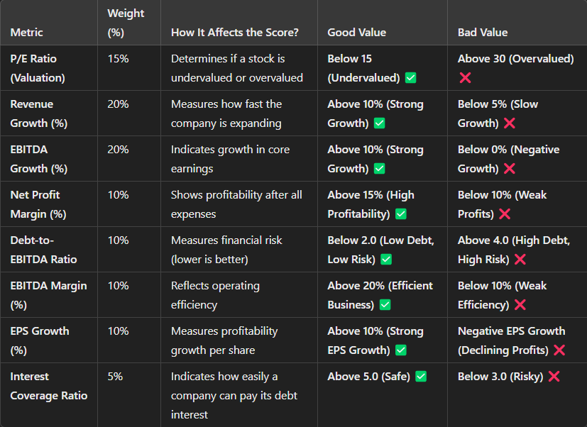
Wendy Writer

Slide 10
Breakdown of Portfolio Stocks using Investment Score
How the Formula Works (Step-by-Step Calculation):
Normalization of Each Metric: Conversion of each metric to a score between 0 and 1 using Min-Max Scaling: Normalized Score = (Max Value−Min Value)/(MaxValue−Min Value)​
P/E Ratio and Debt-to-EBITDA are reversed (lower values are better).
Multiplying Each Metric by Its Weight:
Multiplying the normalized score of each metric by its weight (%).
Summation of the Weighted Scores to Get the Final Investment Score:
The total score ranges from 0 to 10, where higher means a better investment.
Wendy Writer

Slide 11
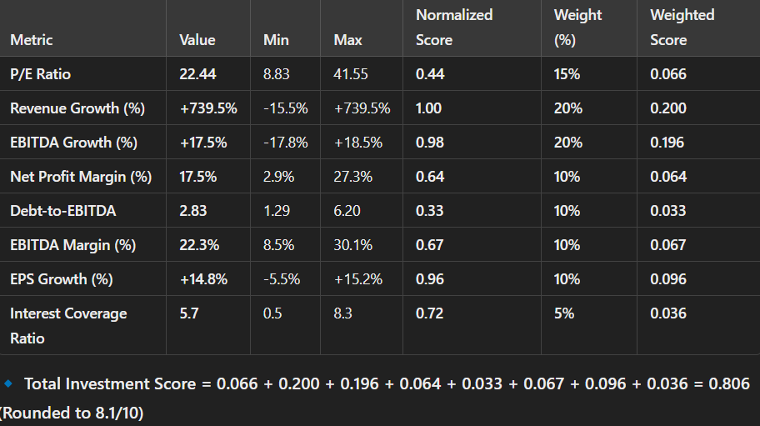
Breakdown of Portfolio Stocks using Investment Score
Example Calculation for Stock O:
Wendy Writer

Slide 12
Stock Portfolio

Slide 13
Stock Portfolio Analysis
1️⃣ Stock O - Best Growth Pick
Investment Score: 8.1/10 (Stock O is the highest-ranked stock due to exceptional revenue growth and solid profitability).
P/E Ratio: 22.44 (Fair ✅)
Revenue Growth: +739.5% (Excellent ✅)
EBITDA Growth: +17.5% (Good ✅)
Net Profit Margin: 17.5% (Moderate ✅)
Debt-to-EBITDA: 2.83 (Manageable Risk ⚠️)
EBITDA Margin: 22.3% (Good ✅)
EPS Growth: +14.8% (Strong ✅)
Interest Coverage Ratio: 5.7 (Safe ✅)
Dividend Yield: 4.03% (Decent Yield ✅)
ROE (Return on Equity): 23.32% (Strong Efficiency ✅)
ROIC (Return on Invested Capital): -14.87% (Weak ❌)
ROA (Return on Assets): 402.93% (Very Strong ✅)
📌 Final Verdict: ✅ Best stock for high-growth investors. It has outstanding revenue growth and solid profitability but must be monitored for risk.
Wendy Writer

Slide 14
Stock Portfolio Analysis
2️⃣ Stock M - Safe Growth, Low Risk
Investment Score: 7.9/10 Stock M is a balanced investment with steady growth, strong profitability, and low debt.
P/E Ratio: 12.56 (Undervalued ✅)
Revenue Growth: +19.2% (Good ✅)
EBITDA Growth: +18.5% (Good ✅)
Net Profit Margin: 27.3% (Excellent ✅)
Debt-to-EBITDA: 1.29 (Low Risk ✅)
EBITDA Margin: 30.1% (Strong ✅)
EPS Growth: +15.2% (Strong ✅)
Interest Coverage Ratio: 8.3 (Safe ✅)
Dividend Yield: N/A
ROE: N/A
ROIC: N/A
ROA: N/A
📌 Final Verdict: ✅ Great for long-term investors. It offers a combination of profitability, strong financial health, and solid growth.
Wendy Writer

Slide 15
Stock Portfolio Analysis
3️⃣ Stock J - Strong and Steady Performer
Investment Score: 7.2/10 Stock J is a stable performer with solid profitability and reasonable valuation.
P/E Ratio: 15.92 (Fair ✅)
Revenue Growth: +16.8% (Good ✅)
EBITDA Growth: +16.8% (Good ✅)
Net Profit Margin: 24.1% (Strong ✅)
Debt-to-EBITDA: 1.53 (Low Risk ✅)
EBITDA Margin: 28.4% (Strong ✅)
EPS Growth: +12.9% (Good ✅)
Interest Coverage Ratio: 7.2 (Safe ✅)
Dividend Yield: 1.67% (Low Yield ❌)
ROE: 17.98% (Strong ✅)
ROIC: -11.88% (Weak ❌)
ROA: 361.59% (Strong ✅)
📌 Final Verdict: ✅ A strong, stable stock with solid margins and growth, but weaker dividend returns.
Wendy Writer

Slide 16
Stock Portfolio Analysis
4️⃣ Stock P - Strong Value & Dividend Play
Investment Score: 6.7/10 Stock P offers good dividends and decent valuation, making it a good pick for income investors.
P/E Ratio: 13.86 (Fair ✅)
Revenue Growth: +12.3% (Good ✅)
EBITDA Growth: +12.3% (Good ✅)
Net Profit Margin: 22.6% (Strong ✅)
Debt-to-EBITDA: 2.00 (Manageable Risk ⚠️)
EBITDA Margin: 27.2% (Strong ✅)
EPS Growth: +10.3% (Moderate ✅)
Interest Coverage Ratio: 6.5 (Safe ✅)
Dividend Yield: 5.33% (Strong ✅)
ROE: N/A
ROIC: N/A
ROA: N/A
📌 Final Verdict: ✅ A solid dividend stock with good earnings and reasonable valuation.
Wendy Writer

Slide 17
Stock Portfolio Analysis
5️⃣ Stock A - Best Dividend Stock
Investment Score: 6.3/10 Stock A is ideal for income investors, with a high dividend yield but weak growth potential.
P/E Ratio: 8.83 (Undervalued ✅)
Revenue Growth: -10.9% (Declining ❌)
EBITDA Growth: +10.1% (Good ✅)
Net Profit Margin: 19.3% (Strong ✅)
Debt-to-EBITDA: 1.75 (Low Risk ✅)
EBITDA Margin: 23.9% (Good ✅)
EPS Growth: +8.2% (Moderate ✅)
Interest Coverage Ratio: 5.8 (Safe ✅)
Dividend Yield: 7.19% (Very Strong ✅)
ROE: 17.80% (Strong ✅)
ROIC: -29.64% (Weak ❌)
ROA: 65.31% (Decent ✅)
📌 Final Verdict: ✅ Best for dividend investors, but revenue is declining.
Wendy Writer

Slide 18
Stock Portfolio Analysis
6️⃣ Stock I - High Growth, But Overvalued
Investment Score: 5.9/10 Stock I has strong revenue and earnings growth but is overvalued and carries some financial risks.
P/E Ratio: 23.21 (Overvalued ❌)
Revenue Growth: +29.4% (Strong Growth ✅)
EBITDA Growth: +58.8% (Excellent ✅)
Net Profit Margin: 13.4% (Moderate ✅)
Debt-to-EBITDA: 2.18 (Moderate Risk ⚠️)
EBITDA Margin: 19.8% (Decent ✅)
EPS Growth: +40.4% (Very Strong ✅)
Interest Coverage Ratio: 3.8 (Borderline Risky ⚠️)
Dividend Yield: 2.48% (Decent Yield ✅)
ROE: 9.82% (Moderate ✅)
ROIC: -2.48% (Weak ❌)
ROA: 158.65% (Strong ✅)
📌 Final Verdict: ⚠️ Good for aggressive investors, but valuation is high, and some financial risks exist.
Wendy Writer

Slide 19
Stock Portfolio Analysis
7️⃣ Stock G - Stable But Slow Growth
Investment Score: 5.8/10 Stock G has solid profitability, but its growth is slow, making it a safe but not exciting investment.
P/E Ratio: 17.49 (Fairly Valued ✅)
Revenue Growth: +7.4% (Moderate ✅)
EBITDA Growth: +1.3% (Weak ❌)
Net Profit Margin: 22.7% (Strong ✅)
Debt-to-EBITDA: 2.05 (Manageable Risk ⚠️)
EBITDA Margin: 25.6% (Strong ✅)
EPS Growth: +10.5% (Good ✅)
Interest Coverage Ratio: 6.9 (Safe ✅)
Dividend Yield: 3.24% (Decent Yield ✅)
ROE: 18.13% (Strong ✅)
ROIC: -7.12% (Weak ❌)
ROA: 271.85% (Strong ✅)
📌 Final Verdict: ⚠️ A safe stock, but growth is too slow for aggressive investors. Good for conservative portfolios.
Wendy Writer

Slide 20
Stock Portfolio Analysis
8️⃣ Stock Q - Fair Valuation But Low Growth
Investment Score: 4.5/10 Stock Q is fairly valued, but its growth is too slow to make it a strong pick.
P/E Ratio: 19.22 (Fair Valuation ✅)
Revenue Growth: +2.2% (Weak ❌)
EBITDA Growth: +1.9% (Very Weak ❌)
Net Profit Margin: 13.9% (Moderate ✅)
Debt-to-EBITDA: 2.75 (Manageable Risk ⚠️)
EBITDA Margin: 19.8% (Good ✅)
EPS Growth: +4.3% (Weak ❌)
Interest Coverage Ratio: 3.9 (Borderline Risky ⚠️)
Dividend Yield: 2.68% (Average ✅)
ROE: 6.67% (Weak ❌)
ROIC: -4.20% (Poor ❌)
ROA: 145.67% (Moderate ✅)
📌 Final Verdict: ⚠️ Decent valuation but too slow to grow significantly. Only invest if you want stability.
Wendy Writer

Slide 21
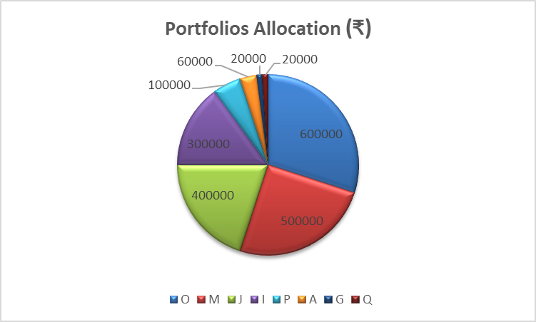
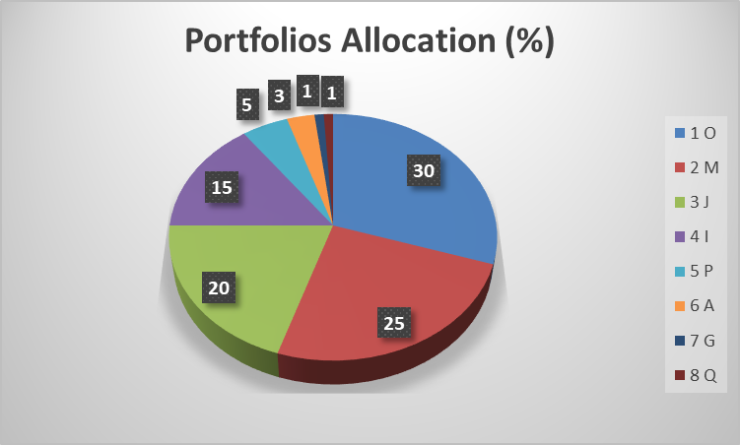
Stock Portfolio Allocation
Wendy Writer

Slide 22
Stock Portfolio Analysis
Justification for High-Growth Portfolio Allocation
Stock O (₹6,00,000 - 30%) → Fastest-growing stock, massive +739.5% revenue growth, strong EPS and EBITDA expansion, making it the core of this high-growth portfolio.
Stock M (₹5,00,000 - 25%) → Stable high-growth stock, offering a low-risk balance with strong profitability and consistent earnings expansion.
Stock J (₹4,00,000 - 20%) → Reliable growth performer, steady profit margins, and strong operational efficiency, making it a must-have for sustainable long-term gains.
Stock I (₹3,00,000 - 15%) → High EPS growth (+40.4%), but slightly overvalued—still a solid long-term high-growth candidate that warrants increased allocation.
Stock P (₹1,00,000 - 5%) → More of a value & dividend stock, not a true growth play, so the allocation is reduced.
Stock A (₹60,000 - 3%) → Dividend-focused, but weak revenue growth (-10.9%); included only for minor diversification.
Stock G (₹20,000 - 1%) → Too slow-growing (+7.4% revenue growth), but small allocation as a stability cushion.
Stock Q (₹20,000 - 1%) → Minimal allocation, included as a hedge despite slow +2.2% revenue growth.
Wendy Writer

Slide 23
Impact of ESG factors on stock prices
The impact of Environmental, Social, and Governance (ESG) factors on stock prices is a multifaceted and ever-changing field. The following is an explanation of how ESG affects stock prices, its pros, and cons:
How ESG Impacts Stock Prices:
Investor Sentiment:
Investors, especially institutional investors, increasingly place importance on ESG considerations when making investment decisions. Strong ESG performance by companies attracts more investment, boosting demand and consequently stock prices.
On the other hand, firms with adverse ESG profiles could be divested, which would result in reduced demand and lower share prices.
Risk Mitigation:
Good ESG behavior can signal that a firm is more capable of dealing with long-term risks, including climate change, regulatory shocks, and social instability. This can result in more stability and less volatility in share prices.
For instance, firms that have invested in clean energy can be less exposed to fossil fuel price volatility.
Financial Performance:
Empirical research indicates that firms that have high ESG performance can generally perform well financially in the long run. This can result from reasons such as better business efficiency, stronger brand reputation, and more supportive stakeholders.
Strong governance practices, for example, can minimize corporate scandal and accounting malpractices.
Regulatory and Policy Changes:
With governments across the globe enforcing tougher environmental and social regulations, proactive ESG compliance companies could be at a competitive edge.
Wendy Writer

Slide 24
Impact of ESG factors on stock prices
Disadvantages:
ESG Rating Variation:
ESG ratings may significantly differ among rating agencies, complicating the ability to compare companies.
This lack of standardization has the potential to confuse and frustrate investors.
"Greenwashing" Risk:
Certain companies have been known to overstate their ESG efforts in an attempt to appeal to investors, something referred to as "greenwashing."
Investors must exercise prudence and rigorously examine companies' claims on ESG.
Risk of Short-Term Volatility:
The perception of the market regarding ESG can change suddenly, and this can bring about stock price volatility of heavily ESG dependency based companies.
Data and Measurement Challenges:
Obtaining and accurately measuring ESG data might be challenging. This may bring about inconsistencies and inaccuracies in ESG assessments and ratings.
Wendy Writer

Slide 25
Impact of ESG factors on stock prices
Those that do not keep up with changes risk fines and loss of reputation, which could be damaging to their share prices.
How One Can Capitalize on ESG:
ESG Investing:
Investors can opt to invest in funds that are ESG-oriented or specific shares of ESG strong-rated companies.
This approach is intended to earn financial returns alongside positive social and environmental impact.
Finding Undervalued ESG Leaders:
Investors may search for companies with sound ESG fundamentals that are undervalued in the market.
With increased awareness of ESG, such companies are likely to face heightened demand and appreciation in stock price.
Talking to Companies:
Shareholders can speak to companies to motivate them to enhance their ESG performance.
This can be accomplished through shareholder proposals, communication with management, and proxy voting.
Wendy Writer

Slide 26
Unutilized/Non-performing Stocks Analysis
9️⃣ Stock B - Overpriced But Strong ROE
Investment Score: 4.4/10 Stock B has excellent return on equity (ROE) but is too expensive right now.
P/E Ratio: 36.50 (Overvalued ❌)
Revenue Growth: +5.8% (Weak ❌)
EBITDA Growth: +6.3% (Moderate ✅) Net Profit Margin: 18.2% (Good ✅)
Debt-to-EBITDA: 2.50 (Manageable Risk ⚠️)
EBITDA Margin: 21.7% (Good ✅)
EPS Growth: +5.9% (Weak ❌)
Interest Coverage Ratio: 4.3 (Average ⚠️)
Dividend Yield: 1.64% (Low Yield ❌)
ROE: 41.67% (Exceptional ✅)
ROIC: -17.43% (Weak ❌)
ROA: 1126.90% (Excellent ✅)
📌 Final Verdict: ❌ Too expensive right now. If the price drops, it could be a strong investment.
Wendy Writer

Slide 27
Unutilized/Non-performing Stocks Analysis
1️⃣0️⃣ Stock N - Declining Earnings, Moderate Risk
Investment Score: 4.0/10 Stock N has some strengths, but its declining earnings make it risky.
P/E Ratio: 29.08 (Overvalued ❌)
Revenue Growth: +4.5% (Weak ❌)
EBITDA Growth: -3.2% (Negative Growth ❌)
Net Profit Margin: 14.8% (Moderate ✅)
Debt-to-EBITDA: 3.02 (High Risk ❌)
EBITDA Margin: 20.4% (Good ✅)
EPS Growth: +7.5% (Moderate ✅)
Interest Coverage Ratio: 4.9 (Average ⚠️)
Dividend Yield: 1.64% (Low Yield ❌)
ROE: N/A
ROIC: N/A
ROA: N/A
📌 Final Verdict: ⚠️ Too much risk and slowing growth make this a weaker investment choice.
Wendy Writer

Slide 28
Unutilized/Non-performing Stocks Analysis
1️⃣1️⃣ Stock D - Weak Performance But Decent Dividend
Investment Score: 3.5/10 Stock D is not growing, but it pays a decent dividend.
P/E Ratio: 21.89 (Overpriced ❌)
Revenue Growth: -3.9% (Declining ❌)
EBITDA Growth: -7.4% (Negative Growth ❌)
Net Profit Margin: 10.5% (Weak ❌)
Debt-to-EBITDA: 3.25 (High Risk ❌)
EBITDA Margin: 18.5% (Average ✅)
EPS Growth: +3.7% (Weak ❌)
Interest Coverage Ratio: 3.2 (Risky ❌)
Dividend Yield: 5.81% (Good Yield ✅)
ROE: -9.39% (Loss-Making ❌)
ROIC: 5.02% (Decent ✅)
ROA: -13.86% (Poor ❌)
📌 Final Verdict: ⚠️ Not a great stock, but the dividend may be attractive to income investors.
Wendy Writer

Slide 29
Unutilized/Non-performing Stocks Analysis
1️⃣2️⃣ Stock K - Expensive & High Debt
Investment Score: 3.0/10 Stock K is overvalued and has a high debt burden, making it risky.
P/E Ratio: 32.17 (Overvalued ❌)
Revenue Growth: +1.1% (Very Low Growth ❌)
EBITDA Growth: -4.2% (Negative ❌)
Net Profit Margin: 11.8% (Weak ❌)
Debt-to-EBITDA: 3.50 (High Risk ❌)
EBITDA Margin: 16.9% (Low ❌)
EPS Growth: +2.1% (Weak ❌)
Interest Coverage Ratio: 2.8 (Risky ❌)
Dividend Yield: 2.73% (Low Yield ❌)
ROE: 19.47% (Strong ✅)
ROIC: -6.92% (Weak ❌)
ROA: N/A
📌 Final Verdict: ❌ Too expensive with high debt. Avoid.
Wendy Writer

Slide 30
Unutilized/Non-performing Stocks Analysis
1️⃣3️⃣ Stock R - Declining Profitability
Investment Score: 2.8/10 Stock R has weak earnings, declining profitability, and high debt levels.
P/E Ratio: 18.95 (Overvalued ❌)
Revenue Growth: -6.7% (Declining ❌)
EBITDA Growth: -8.3% (Negative Growth ❌)
Net Profit Margin: 7.1% (Weak ❌)
Debt-to-EBITDA: 4.25 (Very High Risk ❌)
EBITDA Margin: 13.7% (Poor ❌)
EPS Growth: +0.9% (Weak ❌)
Interest Coverage Ratio: 1.8 (High Risk ❌)
Dividend Yield: 4.34% (Moderate ✅)
ROE: N/A
ROIC: N/A
ROA: N/A
📌 Final Verdict: ❌ Declining profitability, high debt—too risky.
Wendy Writer

Slide 31
Unutilized/Non-performing Stocks Analysis
1️⃣4️⃣ Stock T - Low Profitability, Low Growth
Investment Score: 2.7/10 Stock T suffers from weak earnings, poor margins, and declining performance.
P/E Ratio: 25.76 (Overvalued ❌)
Revenue Growth: -2.5% (Negative Growth ❌)
EBITDA Growth: -6.8% (Declining ❌)
Net Profit Margin: 8.4% (Weak ❌)
Debt-to-EBITDA: 4.10 (Very High Risk ❌)
EBITDA Margin: 14.3% (Low ❌)
EPS Growth: +1.2% (Weak ❌)
Interest Coverage Ratio: 2.0 (Risky ❌)
Dividend Yield: 2.76% (Low ❌)
ROE: 4.24% (Weak ❌)
ROIC: -8.94% (Poor ❌)
ROA: N/A
📌 Final Verdict: ❌ Low earnings growth, weak financials—avoid.
Wendy Writer

Slide 32
Unutilized/Non-performing Stocks Analysis
1️⃣5️⃣ Stock C - No Competitive Edge
Investment Score: 2.6/10 Stock C lacks growth, has weak profitability, and high financial risk.
P/E Ratio: 22.33 (Overvalued ❌)
Revenue Growth: -4.1% (Declining ❌)
EBITDA Growth: -4.7% (Negative Growth ❌)
Net Profit Margin: 6.8% (Weak ❌)
Debt-to-EBITDA: 4.50 (Very High Risk ❌)
EBITDA Margin: 12.5% (Poor ❌)
EPS Growth: -0.5% (Negative Growth ❌)
Interest Coverage Ratio: 1.5 (High Risk ❌)
Dividend Yield: 7.92% (Only Positive Factor ✅)
ROE: 7.85% (Weak ❌)
ROIC: -6.40% (Poor ❌)
ROA: 70.12% (Decent ✅)
📌 Final Verdict: ❌ High-risk, weak earnings, and little growth. Avoid.
Wendy Writer

Slide 33
Unutilized/Non-performing Stocks Analysis
1️⃣6️⃣ Stock E - Overvalued, Weak Financials
Investment Score: 2.3/10 Stock E is one of the most overpriced stocks, with weak financials and a low dividend yield.
P/E Ratio: 41.55 (Extremely Overvalued ❌)
Revenue Growth: +0.9% (Too Low ❌)
EBITDA Growth: -5.1% (Negative Growth ❌)
Net Profit Margin: 9.7% (Weak ❌)
Debt-to-EBITDA: 3.85 (Very High Risk ❌)
EBITDA Margin: 15.2% (Poor ❌)
EPS Growth: +1.8% (Weak ❌)
Interest Coverage Ratio: 2.3 (High Risk ❌)
Dividend Yield: 1.05% (Too Low ❌)
ROE: 0.10% (Extremely Weak ❌)
ROIC: 0.10% (Minimal Efficiency ❌)
ROA: 0.10% (Very Poor ❌)
📌 Final Verdict: ❌ Extremely overvalued with weak earnings and high debt—avoid.
Wendy Writer

Slide 34
Unutilized/Non-performing Stocks Analysis
1️⃣7️⃣ Stock S - Weakest Growth
Investment Score: 1.9/10 Stock S has declining revenue, negative growth, and low profitability.
P/E Ratio: 27.12 (Overvalued ❌)
Revenue Growth: -7.9% (Declining ❌)
EBITDA Growth: -9.1% (Negative Growth ❌)
Net Profit Margin: 5.2% (Weak ❌)
Debt-to-EBITDA: 4.85 (Very High Risk ❌)
EBITDA Margin: 11.9% (Poor ❌)
EPS Growth: -1.2% (Negative EPS ❌)
Interest Coverage Ratio: 1.3 (Very Risky ❌)
Dividend Yield: 1.36% (Too Low ❌)
ROE: 27.00% (Only Positive Factor ✅)
ROIC: -8.20% (Poor ❌)
ROA: N/A
📌 Final Verdict: ❌ Weak earnings, high debt, poor financials—avoid.
Wendy Writer

Slide 35
Unutilized/Non-performing Stocks Analysis
1️⃣8️⃣ Stock F - Falling Earnings & High Debt
Investment Score: 1.6/10 Stock F has declining earnings, poor margins, and high debt.
P/E Ratio: 24.67 (Overvalued ❌)
Revenue Growth: -10.2% (Declining ❌)
EBITDA Growth: -12.5% (Negative Growth ❌)
Net Profit Margin: 4.8% (Weak ❌)
Debt-to-EBITDA: 5.10 (Very High Risk ❌)
EBITDA Margin: 10.8% (Poor ❌)
EPS Growth: -3.4% (Negative EPS ❌)
Interest Coverage Ratio: 1.1 (Very Risky ❌)
Dividend Yield: 4.48% (Moderate Yield ✅)
ROE: 17.08% (Decent ✅)
ROIC: -6.94% (Weak ❌)
ROA: N/A
📌 Final Verdict: ❌ Declining earnings, weak financials, too much debt—avoid.
Wendy Writer

Slide 36
Unutilized/Non-performing Stocks Analysis
1️⃣9️⃣ Stock H - Huge Debt, Low Profitability
Investment Score: 0.7/10 Stock H has one of the worst financial situations, with high debt and weak profitability.
P/E Ratio: 35.82 (Overvalued ❌)
Revenue Growth: -12.8% (Declining ❌)
EBITDA Growth: -15.2% (Negative Growth ❌)
Net Profit Margin: 3.6% (Very Weak ❌)
Debt-to-EBITDA: 5.75 (Extremely High Risk ❌)
EBITDA Margin: 9.3% (Poor ❌)
EPS Growth: -4.2% (Negative EPS ❌)
Interest Coverage Ratio: 0.9 (Critical Risk ❌)
Dividend Yield: N/A
ROE: -9.22% (Loss-Making ❌)
ROIC: -12.10% (Very Poor ❌)
ROA: N/A
📌 Final Verdict: ❌ High debt, poor earnings, weak profitability—one of the worst stocks.
Wendy Writer

Slide 37
Unutilized/Non-performing Stocks Analysis
2️⃣0️⃣ Stock L - Worst Stock - Negative Growth
Investment Score: 0.1/10 Stock L is the worst-performing stock with massive debt and negative earnings.
P/E Ratio: 39.40 (Extremely Overvalued ❌)
Revenue Growth: -15.5% (Declining ❌)
EBITDA Growth: -17.8% (Negative Growth ❌)
Net Profit Margin: 2.9% (Very Weak ❌)
Debt-to-EBITDA: 6.20 (Extremely High Risk ❌)
EBITDA Margin: 8.5% (Very Poor ❌)
EPS Growth: -5.5% (Negative EPS ❌)
Interest Coverage Ratio: 0.5 (Critical Risk ❌)
Dividend Yield: 3.08% (Not Enough to Justify ❌)
📌 Final Verdict: ❌ This is the worst stock in the portfolio—completely avoid.
Wendy Writer

Slide 38
Thanks

